Slide 1
Flight Delay Prediction For Aviation Industry Using Machine Learning

Slide 2
Team Members
Sriram K
Jeeva V
Rajesh B
Sabarinathan M

Slide 3
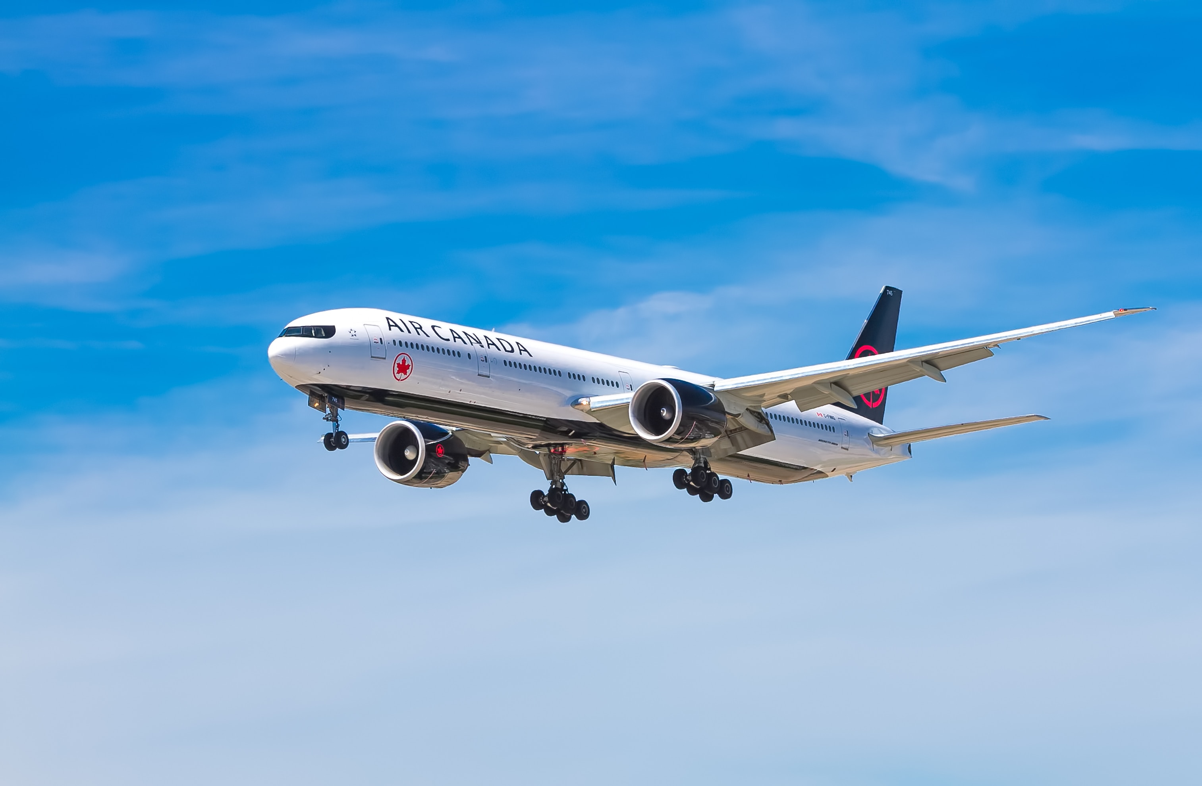
Agenda
Introduction
Machine Learning
Screen Design
Output Result
Conclusion

Slide 4
1.Introduction
Flight delay is extremely troublesome to passengers and aviation authorities. Apart from the disruption of the schedule, flight delays cause monumental financial losses to the airline company. To accommodate the unforeseen delay in the arrival of a flight, a reallocation of airport resources, impromptu crew management and a redraft of flight schedules may arise. In some cases, the airline may be required to compensate the passengers for the delay.
To address this issue, this project aims to design a two-stage machine learning engine to predict the arrival delay of flights accurately. Flight delay prediction involves the pipelined operation of two sequential tasks: predicting whether a flight will be delayed or not (classification) and if the flight is delayed, to predict the arrival delay in minutes (regression). The model is trained on a dataset synthesized from 15 airports in the USA for which weather data is available and merged with the corresponding flight data from 2016 to 2017. The performance of various classification and regression models is studied and compared before constructing the pipelined engine.
Section 2 explains how the flight and weather data were processed and merged to construct the dataset. Section 3 and Section 4 deal with how different classifiers and regressors were trained and analyzed on the dataset respectively. Finally, Section 5 details the two-stage pipelined model to predict flight delay.

Slide 5
2.Machine Learning
Data Collection: Describe the source of the data used in the project and provide an overview of the dataset.
Data Preprocessing: Explain the steps taken to prepare the data for machine learning, including data cleaning, feature engineering, and feature selection.
Exploratory Data Analysis: Present the findings of the exploratory data analysis, including visualizations and insights gained from the data.
Model Selection: Describe the various machine learning algorithms considered for the project and explain why a particular algorithm was chosen.
Model Training: Explain how the chosen machine learning algorithm was trained on the dataset.
Model Evaluation: Present the results of the model evaluation, including the metrics used to assess the performance of the model.
Hyperparameter Tuning: Describe the process of tuning the hyperparameters of the model to improve its performance.
Prediction: Provide examples of how the model can be used to predict the flight will be delayed

Slide 6
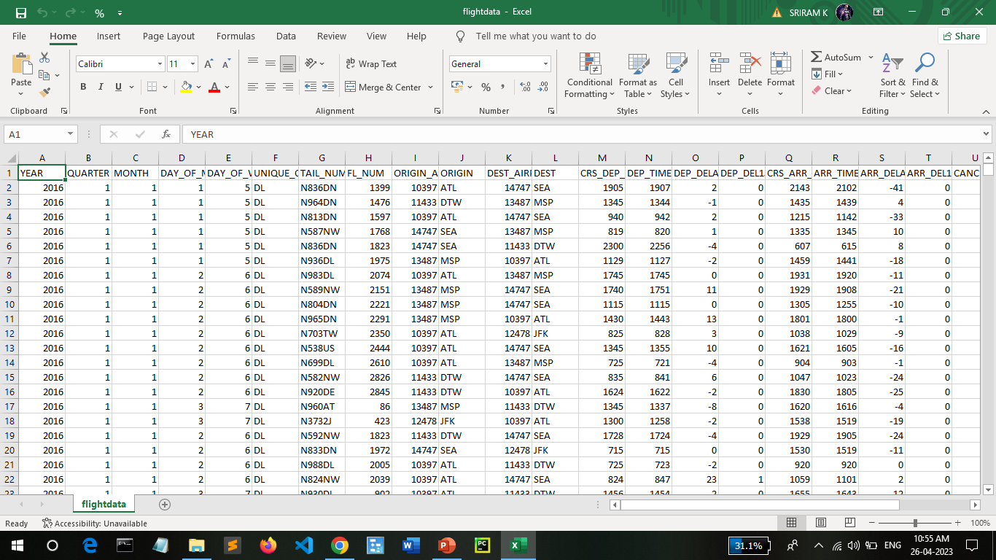
Dataset:
In this project we have used .csv data. This data is downloaded from google drive. Please refer to the link given below to download the dataset.
Link: flightdata.csv - Google Drive

Slide 7
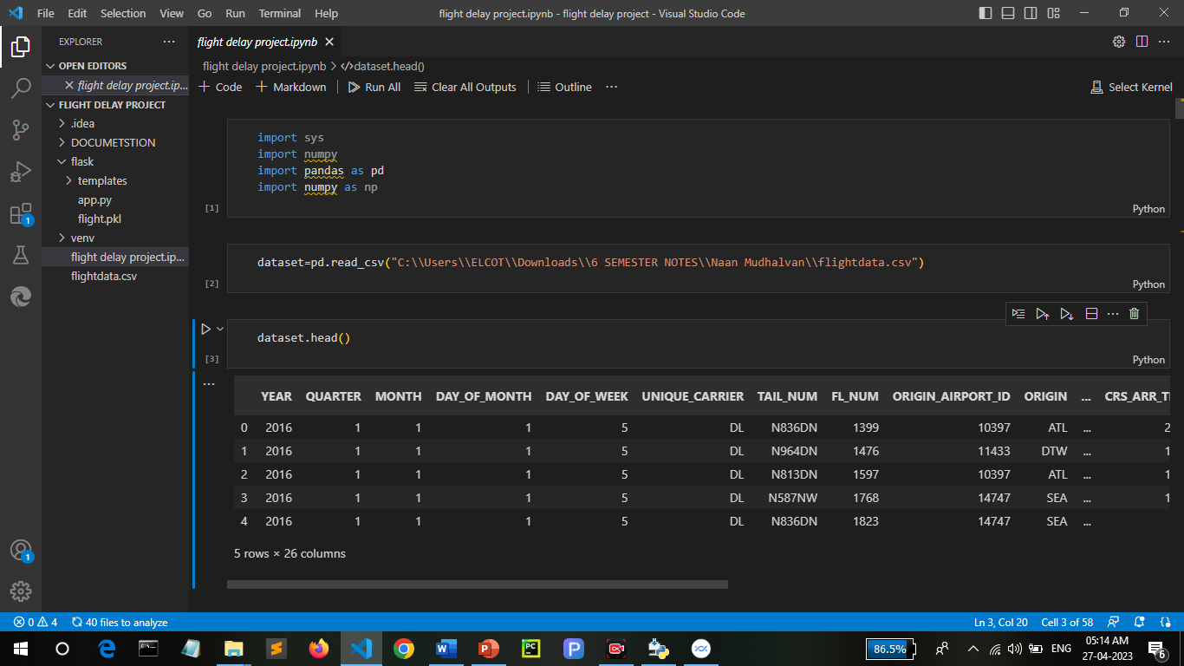
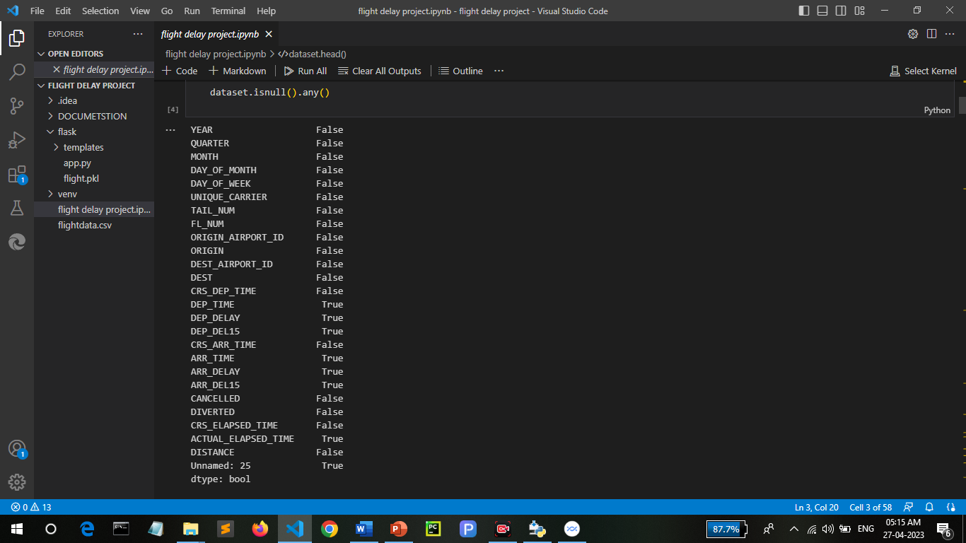
Data Preprocessing
As we have understood how the data is, let's pre-process the collected data.
The download data set is not suitable for training the machine learning model as it might have so much randomness so we need to clean the dataset properly in order to fetch good results. This activity includes the following steps.
Handling missing values
Handling categorical data
Handling Imbalance Data

Slide 8
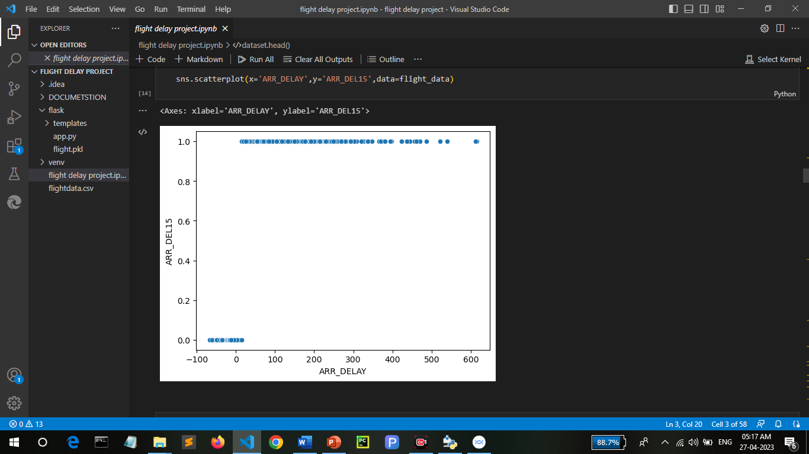
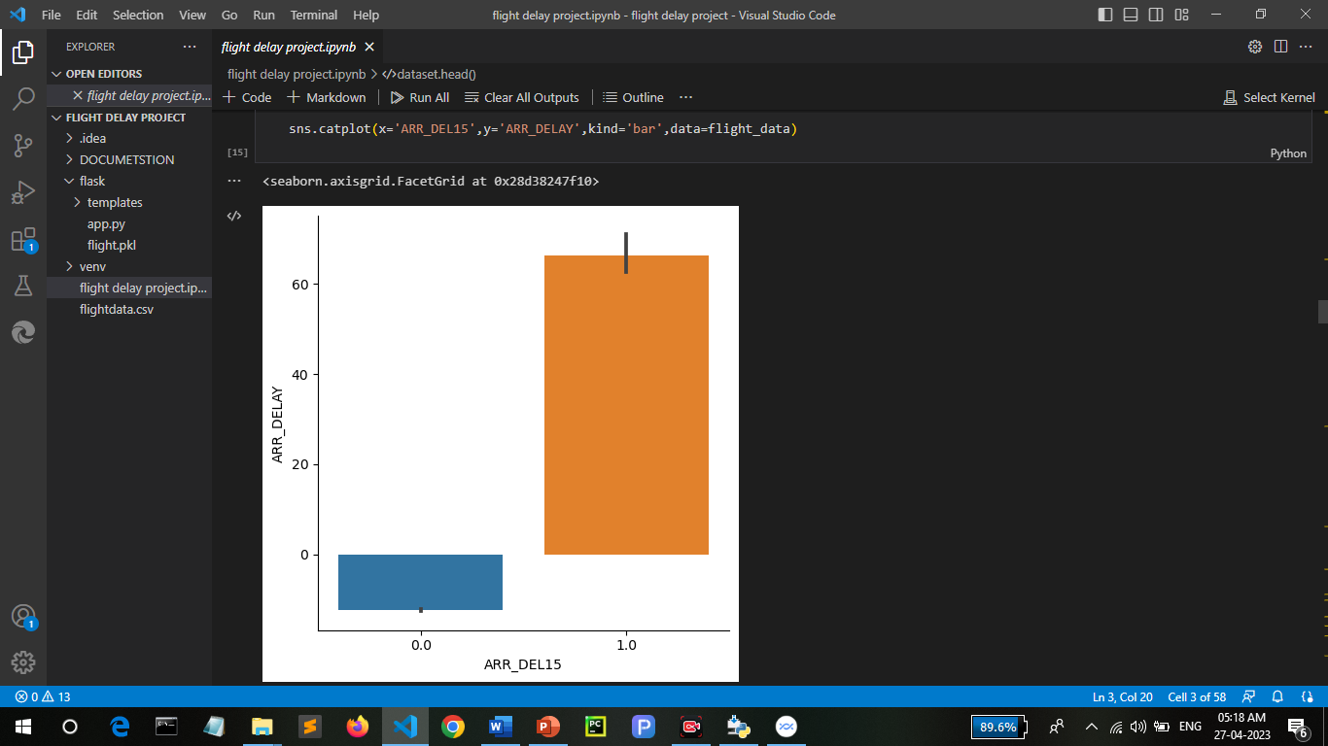
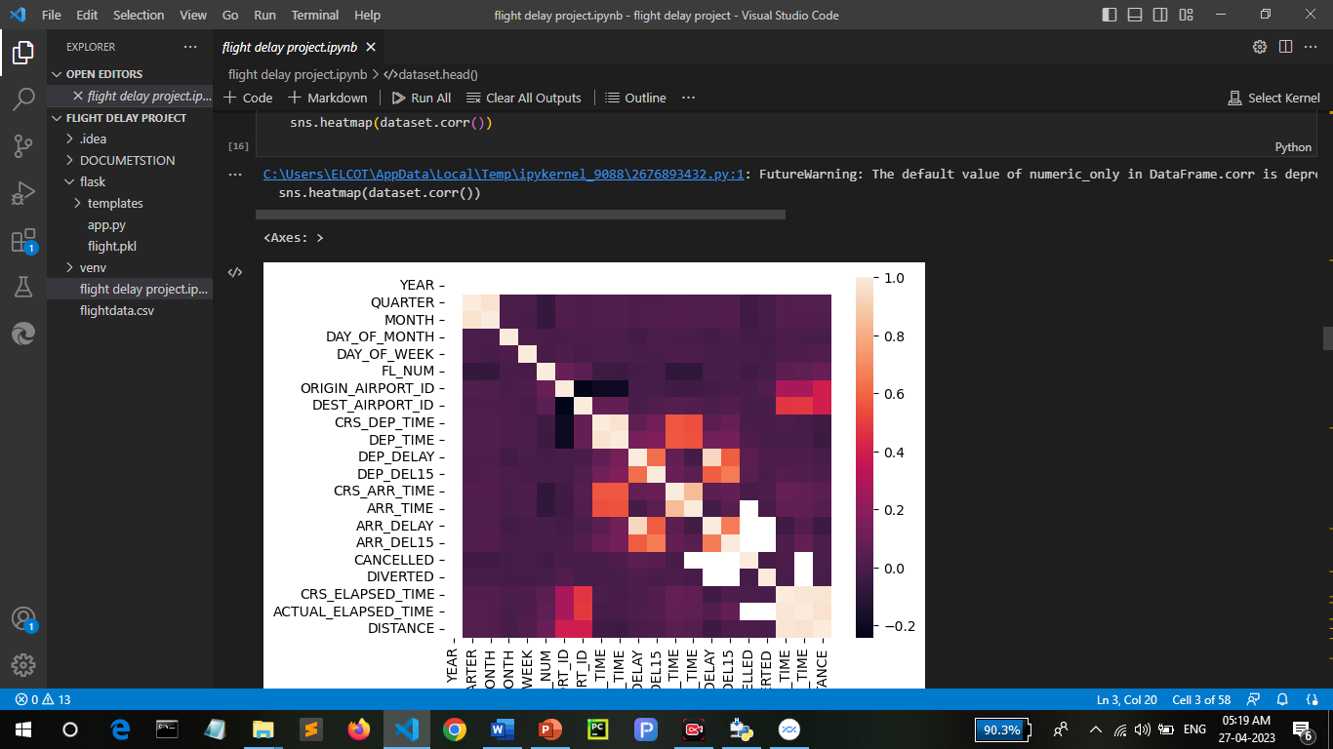
Exploratory Data Analysis
Descriptive Statistical: Descriptive analysis is to study the basic features of data with the statistical process. Here pandas has a worthy function called describe. With this describe function we can understand the unique, top and frequent values of categorical features. And we can find mean, std, min, max and percentile values of continuous features.
Visual Analysis: Visual analysis is the process of using visual representations, such as charts, plots, and graphs, to explore and understand data. It is a way to quickly identify patterns, trends, and outliers in the data, which can help to gain insights and make informed decisions.
Univariate Analysis: In simple words, univariate analysis is understanding the data with a single feature. Here we have displayed two different graphs such as distplot and countplot.
Bivariate analysis: Bivariate analysis is a statistical method that involves the analysis of the relationship between two variables. In other words, it is the study of the relationship between two variables to determine whether there is a correlation between them or not.
Multivariate Analysis: In simple words, multivariate analysis is to find the relation between multiple features. Here we have used a swarm plot from the seaborn package.

Slide 9
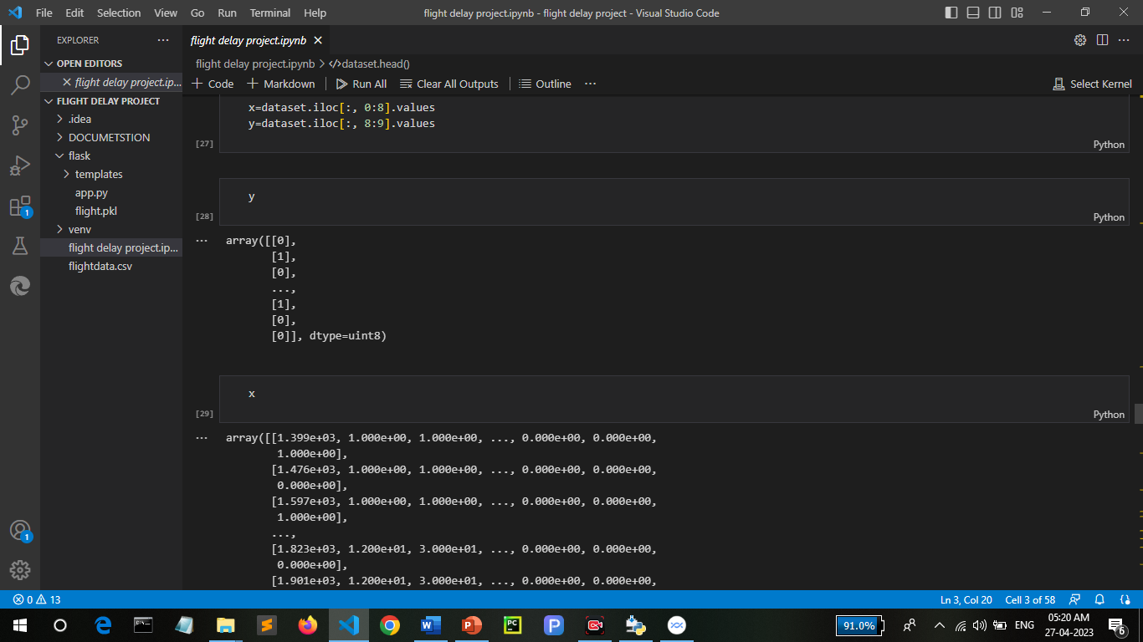
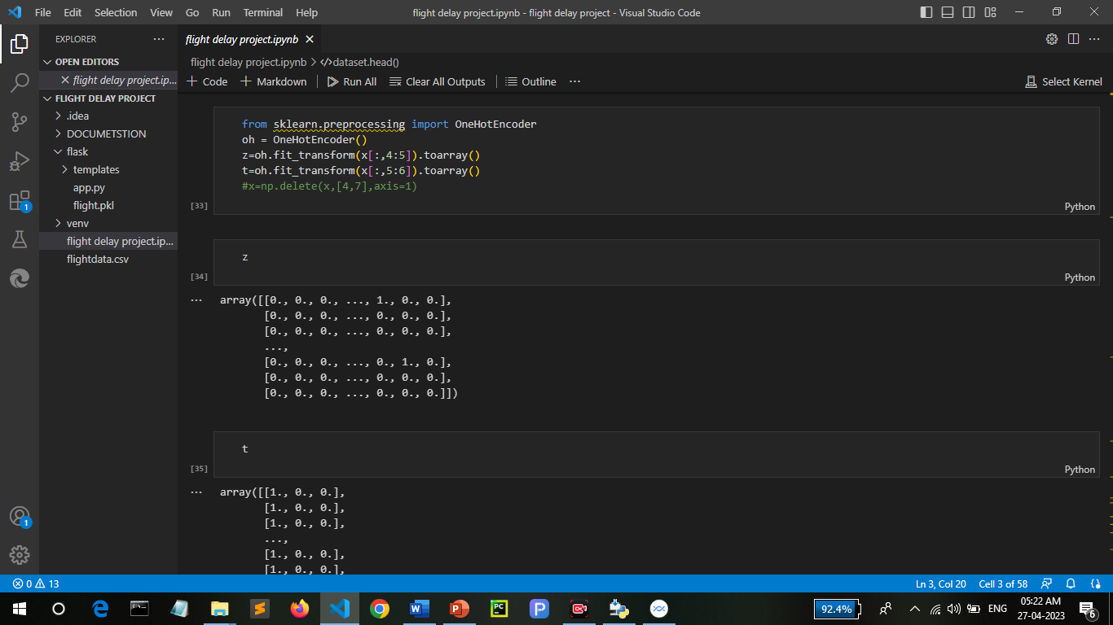
Model Selection
Decision Tree Model: A function named decisionTree is created and train and test data are passed as the parameters. Inside the function, DecisionTreeClassifier algorithm is initialised and training data is passed to the model with the .fit() function. Test data is predicted with .predict() function and saved in a new variable. For evaluating the model, a confusion matrix and classification report is done.
Random Forest Model: A function named randomForest is created and train and test data are passed as the parameters. Inside the function, RandomForestClassifier algorithm is initialised and training data is passed to the model with .fit() function. Test data is predicted with .predict() function and saved in a new variable. For evaluating the model, a confusion matrix and classification report is done.
.

Slide 10
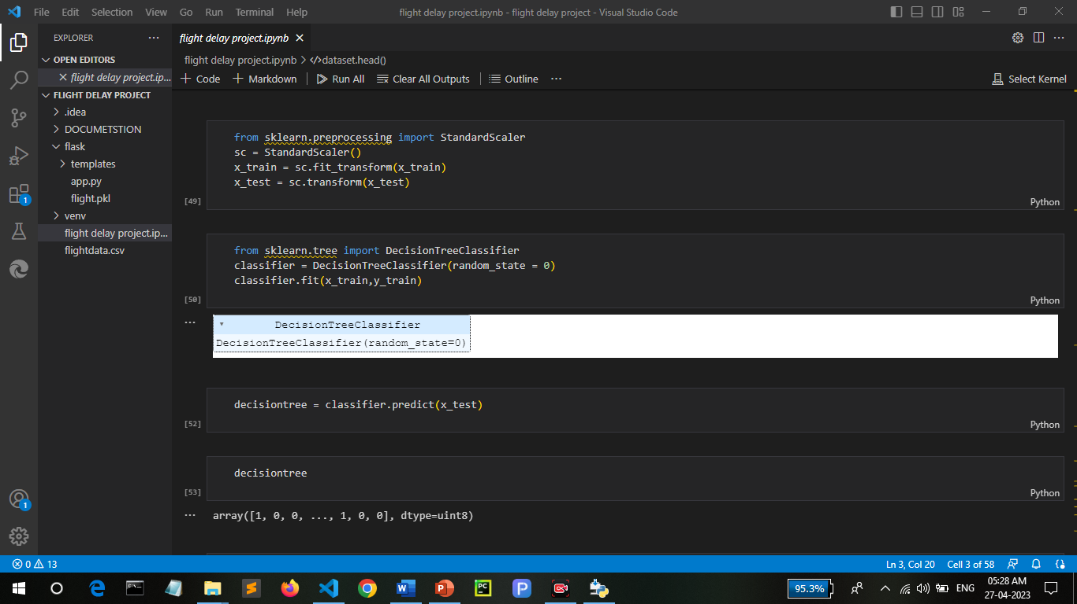
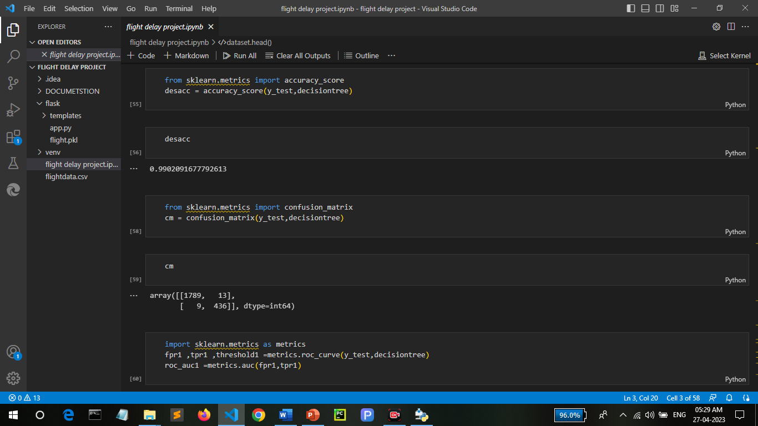
Model Evaluation
Multiple evaluation metrics means evaluating the model's performance on a test set using different performance measures. This can provide a more comprehensive understanding of the model's strengths and weaknesses. We are using evaluation metrics for classification tasks including accuracy, precision, recall, support and F1-score.

Slide 11
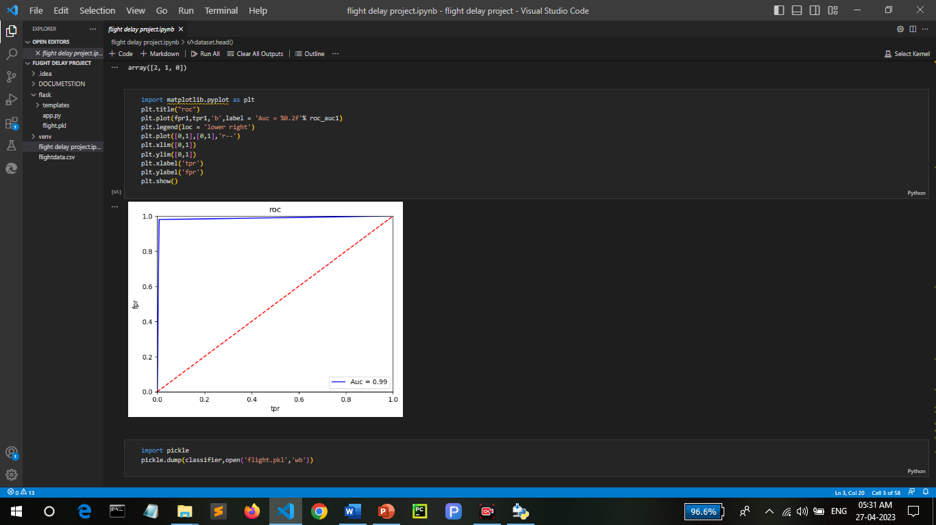
Hyperparameter Tuning
Evaluating performance of the model From sklearn, cross_val_score is used to evaluate the score of the model. On the parameters, we have given rf (model name), x, y, cv (as 5 folds). Our model is performing well. So, we are saving the model by pickle.dump().

Slide 12
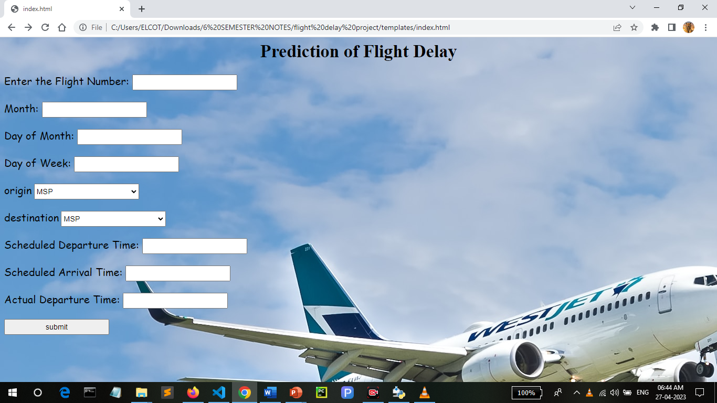
3. Screen Design
home.html:

Slide 13


Slide 14

4. Output Result

Slide 16


5. Conclusion
The ﬂight and weather data were combined into a single dataset and preprocessed to train a two-stage machine learning model that predicts ﬂight arrival delay.
Due to class imbalance, there was an inherent bias towards the majority class, ‘Not Delayed’ ﬂights (class 0). The data was sampled using SMOTE before classiﬁcation to overcome the bias.
Out of several classiﬁcation algorithms, the Random Forest classiﬁer gave the best F1 score (0.78) and Recall (0.74) for the delayed ﬂights. Subsequently, the Random Forest regressor was pipelined, giving MAE 7.178 minutes and RMSE 11.283 minutes with an R-squared score of 0.977. ‘
In conclusion, the ﬂight delay prediction was eﬃcient and the Machine Learning model exhibited good performance.

Slide 17
Thank you

